Slide 1
Fitness Buddy
IBM AICTE PROJECT
Presented By: Muskan Gupta
Student name :Muskan Gupta
College Name & Department :Galgotias University, SCAT Department

Slide 2
OUTLINE
Problem Statement
Technology used
Wow factor
End users
Result
Conclusion
Git-hub Link
Future scope
IBM Certifications

Slide 3
Problem Statement
Many people struggle to stay fit due to busy schedules, lack of motivation, and no access to personalized fitness guidance. Most fitness apps are costly and not user-friendly.
Proposed Solution: Fitness Buddy, a virtual assistant built with IBM Watsonx, helps by offering quick home workouts, healthy meal ideas, and motivational tips—making fitness easy and accessible for everyone.

Slide 4
Technology used
IBM Watsonx Assistant – To create and manage the chatbot (Fitness Buddy).
IBM Cloud – Platform used to host and manage Watson Assistant.
Natural Language Processing (NLP) – Underlying tech used by Watsonx to understand user queries.
Intent & Action-Based Workflow – For customizing conversations and responses.
JSON – For exporting the chatbot configuration.

Slide 5
IBM cloud services used
IBM Cloud Watsonx AI Studio
IBM Cloud Watsonx AI runtime
IBM Granite foundation model
IBM Watsonx Assistant (Lite Plan)

Slide 6
Wow factors
No-Code Smart Assistant Built using IBM Watsonx Assistant without writing a single line of code — fully functional chatbot with logical flow and natural responses.
24x7 Virtual Fitness Guide Acts as a personal coach available anytime, giving instant responses to workout, meal, habit, and motivation queries.
Custom Actions with Intelligent Responses Multiple actions designed for different user needs — personalized experience based on the user’s query.
Cloud-Based Deployment Deployed entirely on the IBM Cloud platform — scalable, reliable, and accessible from anywhere.

Slide 7
End users
Students and Working Professionals People with busy schedules looking for quick and reliable fitness guidance.
Beginners in Fitness Individuals who are new to exercise and healthy eating, needing simple suggestions and motivation.
Remote Users or Home Workout Enthusiasts Users who prefer working out at home without the need for a personal trainer.
Health-Conscious Individuals Anyone interested in maintaining a healthy lifestyle with consistent habits and motivation.

Slide 8
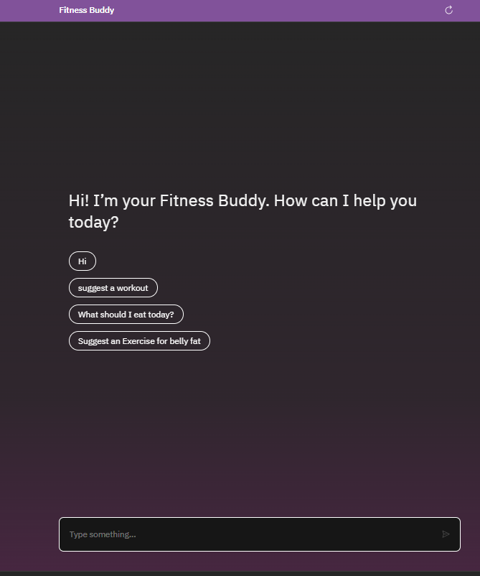
Results

Slide 9
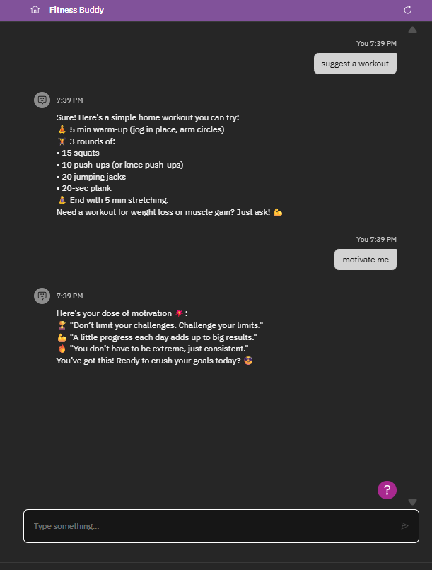
Results

Slide 10
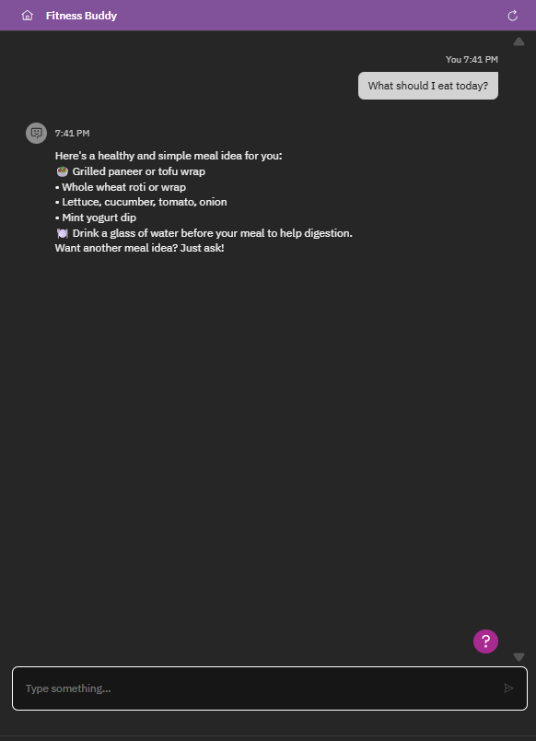
Results

Slide 11
Conclusion
The Fitness Buddy chatbot successfully demonstrates how AI can support a healthy lifestyle by providing personalized guidance, motivational support, and daily habit tips—all through a user-friendly interface. Built using IBM Watsonx Assistant on IBM Cloud, this virtual assistant offers accessible and smart fitness help to users anytime, anywhere. It bridges the gap between health goals and real-world challenges like lack of time, motivation, or expert advice.

Slide 12
GitHub Link
https://github.com/Muskan753951/fitness-buddy-chatbot

Slide 13
Future scope
Add voice-enabled interaction for hands-free experience.
Integrate with smart fitness devices (e.g., Fitbit, smartwatches).
Provide personalized fitness and diet plans using user history.
Enable multilingual support for diverse user base.
Send daily workout reminders via SMS or WhatsApp.

Slide 14
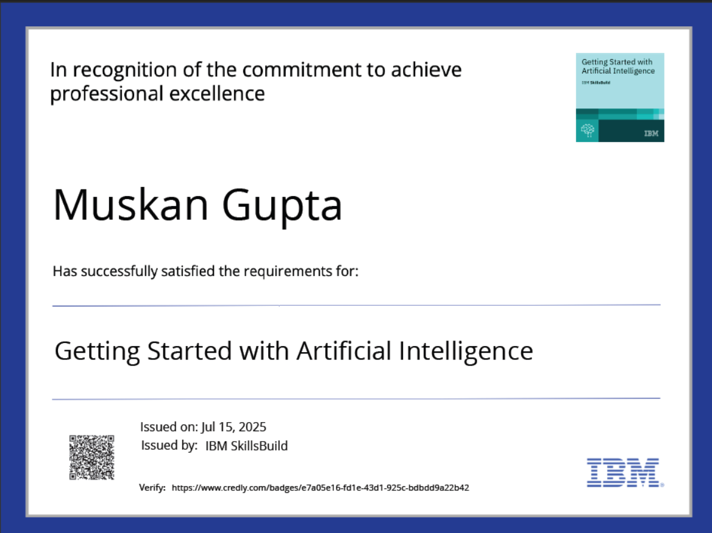

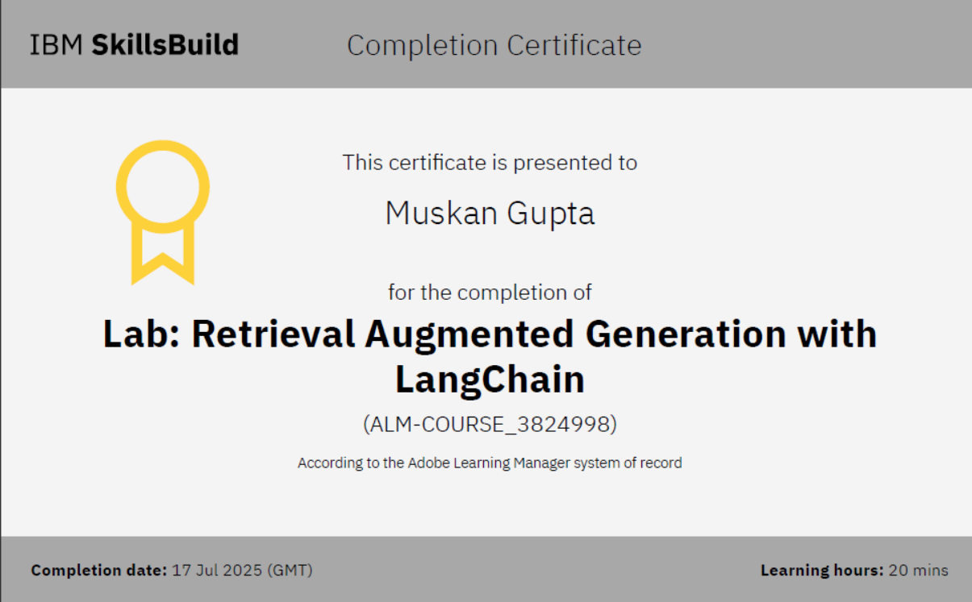
IBM Certifications

Slide 15
THANK YOU

